Slide 1

University Institute of Engineering
DEPARTMENT OF COMPUTER SCIENCE & ENGINEERING
Bachelor of Engineering (Computer Science & Engineering)
Subject Name : SEO
Subject Code: 20CST-463
Topic: Lecture-1.3.1
Lecture- SEO Analytics
By : Sourabh Budhiraja
DISCOVER . LEARN . EMPOWER

Slide 2
Syllabus
UNIT-1: Introduction to SEO
CHAPTER-1: Introduction to Search Engine Optimization:
Introduction to search engine optimization, Basics of SEO, Keyword Research, On-Page Optimization, Technical SEO.
CHAPTER-2: Content Creation and SEO tools:
Content Creation for SEO, SEO Analytics, SEO Tools, Local SEO, SEO Ethics and Future Trends.

Slide 3
CONTENTS
SEO Analytics

Slide 4
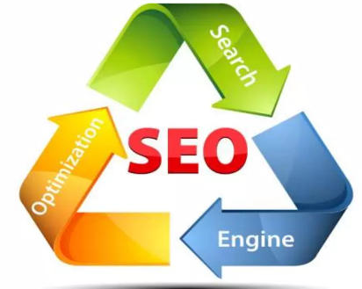
What is Search Engine Optimization?
SEO, which stands for Search Engine Optimization, is a crucial aspect of digital marketing and online visibility. It involves optimizing a website or online content to improve its visibility and ranking in search engine results pages (SERPs).

Slide 5
What is SEO Analytics
SEO analytics are a collection of key performance indicators (KPIs) and metrics. These insights help you understand how well your website is performing in search engines. Plus, they identify opportunities for improving search engine results pages (SERPs) rankings, website traffic, and conversions.
Analytics for SEO usually include metrics and KPIs like:
Organic traffic
Keyword rankings
Average ranking
Impressions
Clicks
Click-through rate (CTR)
Domain authority (also known as domain rating or website authority)
Referring domains
Backlinks

Slide 6
What is SEO Analytics
While both metrics and KPIs are quantifiable values, the former tend to be operational or tactical. Basically, metrics are data points used to measure user engagement, organic traffic, conversions, and other aspects related to SEO.
KPIs, on the other hand, provide the insights you need to measure your progress against set goals. For example, you can track your rankings for specific keywords. Or check the number of bookings coming from your site.

Slide 7
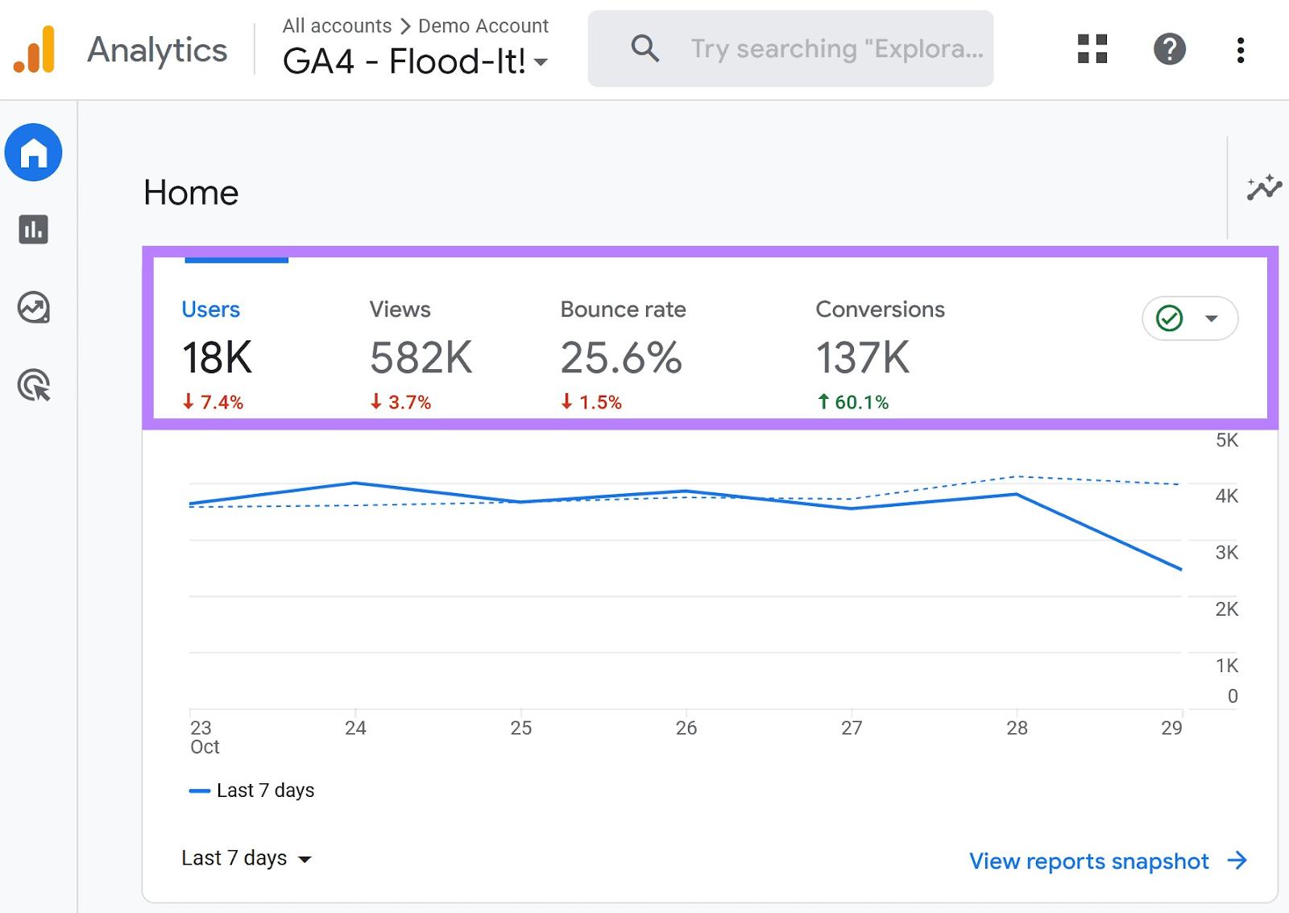
SEO Analytics vs. General Website Analytics
General website analytics tell you about the behavior of users on your website. SEO web analytics show you how your site is performing on search engines.
They’re not quite the same.
You’re probably familiar with web analytics tools like Google Analytics. They provide metrics like users, page views, bounce rate, conversion rate, and session duration.

Slide 8
SEO Analytics vs. General Website Analytics
Web analytics give you a broad view of how website visitors interact with your site, your site’s overall user experience, and your digital marketing performance. For tracking SEO, Google Analytics can only provide high-level data about how much traffic your site has received from search engines. On the other hand, SEO data from a reputable SEO tool or services like Google Search Console help you see how your site appears in search. They indicate which search terms return pages from your site. And how you can optimize your SEO efforts to bring in more traffic. It’s like an indoor security camera versus an outdoor security camera.
SEO analytics tell you how people got to your home (your site). Website analytics tell you what happens once they’re inside.

Slide 9
SEO Analytics vs. General Website Analytics
Some common SEO metrics fall into both camps.
For instance, if you analyze the conversion rate of SEO traffic, it would include:
How they got to your site (from search engines)
Their behavior on your website (conversion rate)
When it comes to tracking analytics, SEO data is a key component of understanding your website’s overall performance.

Slide 10
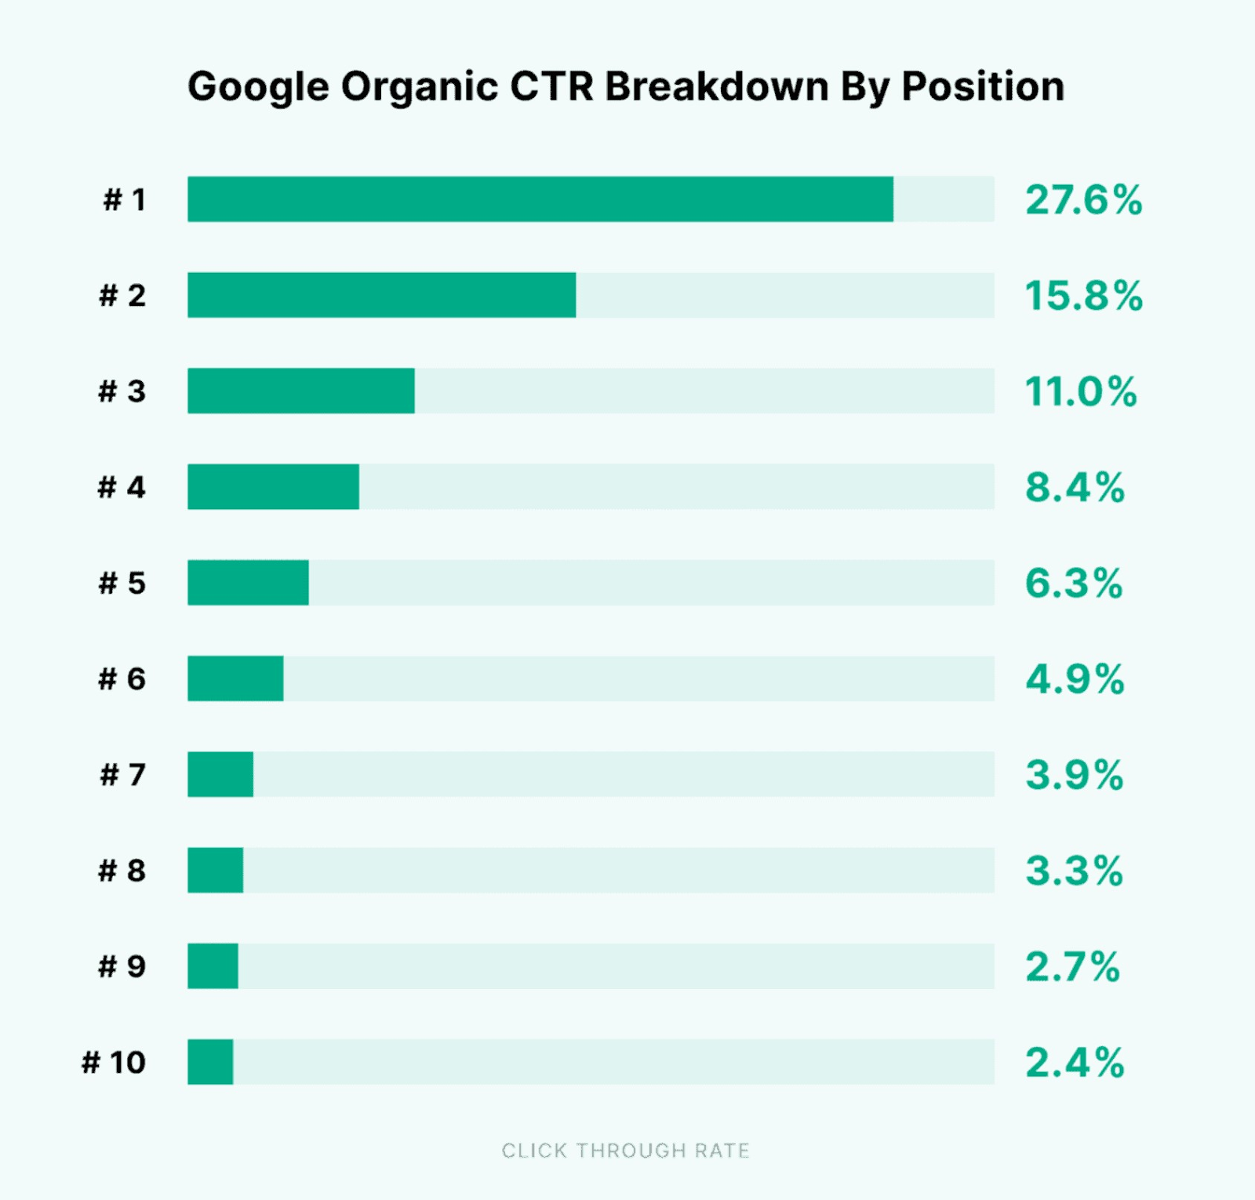
Why Are SEO Analytics Important?
SEO analytics can help you understand the changes in search engine performance that influence your website’s traffic, conversions, and revenue.A relatively small change can have a big effect. Say one of your main landing pages ranks first for a keyword like “toaster ovens.” It then drops to position three.According to a Backlinko study, your CTR for that keyword could drop from 27.6% to about 11%.

Slide 11
How to Use SEO Analytics to Improve Website Performance
Marketers can leverage SEO analytics to gain insights into a website’s performance over time. These figures allow them to continuously refine their approach and identify opportunities. However, this data is pretty much useless if you don’t know what to look for. That’s why you need to define and track the right metrics, make adjustments as needed, and measure the results over time.
For example, you can use analytics to answer the following questions:
What keywords are you ranking for?
What keywords are your competitors using?
Where do your customers come from?
Why are they leaving your site?
Which marketing strategies bring in the most traffic?
Which products or pages get the most views?
How is your website performing across different devices and geographic regions?
Who is linking to your website?

Slide 12
How to Use SEO Analytics to Improve Website Performance
Take the following steps to track your metrics and achieve higher search engine rankings.
Choose the Right SEO Metrics
Tracking the right data will help you perform more meaningful SEO analysis. It will also identify important optimization opportunities, meaning you can have a greater impact on your site’s organic traffic.
First, decide which metrics and KPIs you want to track. These may include, but are not limited to:

Slide 13
Steps to track your metrics and achieve higher search engine rankings.
Organic traffic
CTR
Average time on page
Session duration
Pages per session
Exit pages
Bounce rate
Conversion rate
Keyword rankings
Number of backlinks

Slide 14
Steps to track your metrics and achieve higher search engine rankings.
User engagement
Cost per acquisition
Ideally, track and analyze the SEO KPIs that align with your marketing goals.
Let’s say you want to keep visitors on your website longer. In this case, it makes sense to measure organic traffic (organic sessions) and the average engagement time per session for that traffic.
This data can be found in Google Analytics.
e found in Google Analytics.

Slide 15
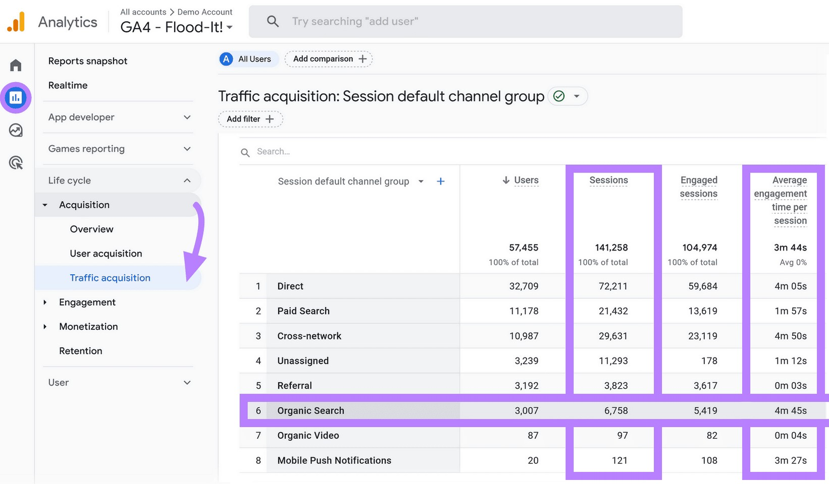
Steps to track your metrics and achieve higher search engine rankings.
For example, you can use SEO analytics reporting data to see which pages get the most clicks and engagement. After that, weed out or optimize your lowest-performing pages.
Here are some of the most important KPIs to keep an eye on:

Slide 16
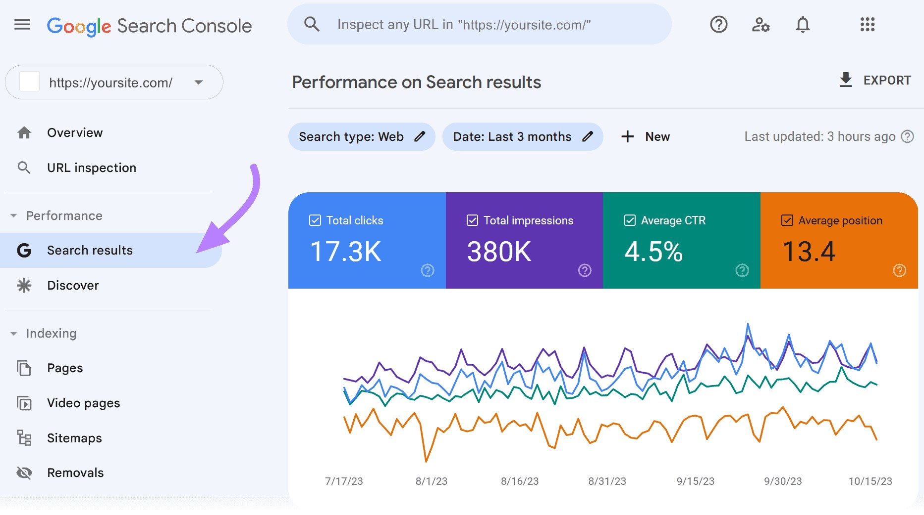
Steps to track your metrics and achieve higher search engine rankings.
Organic Search Traffic
Start by tracking KPIs that tell you about your overall visibility on and traffic from search engines. Monitoring these over time will help you understand if your site’s search footprint is growing or shrinking. You can measure this growth using Google Search Console (GSC). This tool provides direct Google SEO analytics data about your site’s performance.If you don’t have GSC set up for your website, follow our guide on how to start using GSC. Once you’ve got everything set up, just click the “Search results” page from the left-hand navigation bar.

Slide 17
Steps to track your metrics and achieve higher search engine rankings.
This report will give you a snapshot of your key metrics related to Google search performance.
Total clicks: The number of clicks to your website from a Google search results page
Total impressions: The total number of times a page on your site appeared in the Google search results
Average CTR (click-through rate): The proportion of impressions that resulted in a click
Average position: The average ranking of your pages when they appeared in the search results

Slide 18

Steps to track your metrics and achieve higher search engine rankings.
You can measure these metrics by time period, giving you the ability to track them weekly, monthly, or on whatever interval makes sense.
You can take this one step further using the Organic Research tool from Semrush.
This allows you to compare your search performance versus competitors.
To do so, click “Organic Research” under “Competitive Research.” Then, type the URL of your competitor’s website in the search box. Click “Search.”

Slide 19
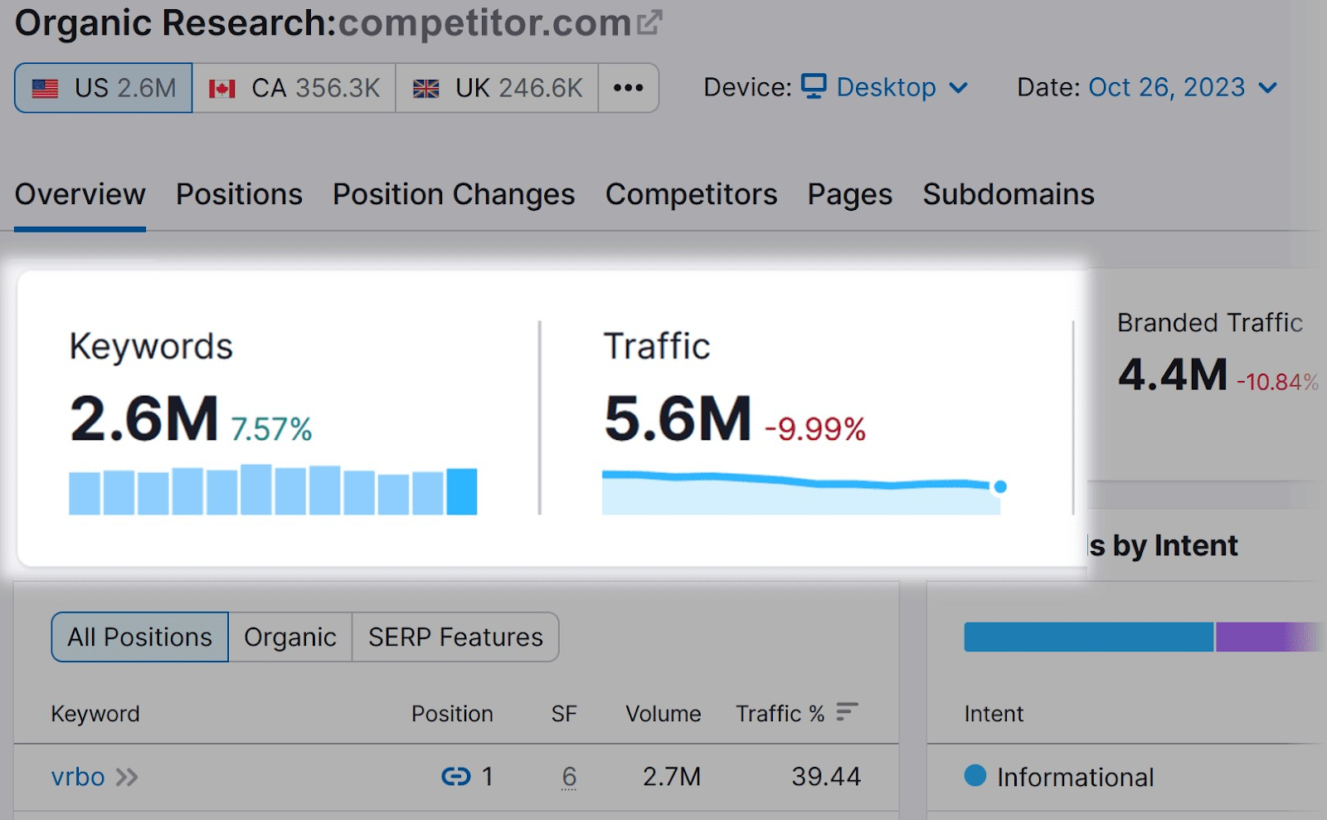
Steps to track your metrics and achieve higher search engine rankings.
The Organic Research report will provide you with estimates on your competitor’s organic performance. It provides metrics like:
Total organic search traffic: Number of users or sessions coming to their site every day, week, or month from organic search
Ranking keywords: Number of keywords for which their site appears anywhere in the top 100 search results

Slide 20
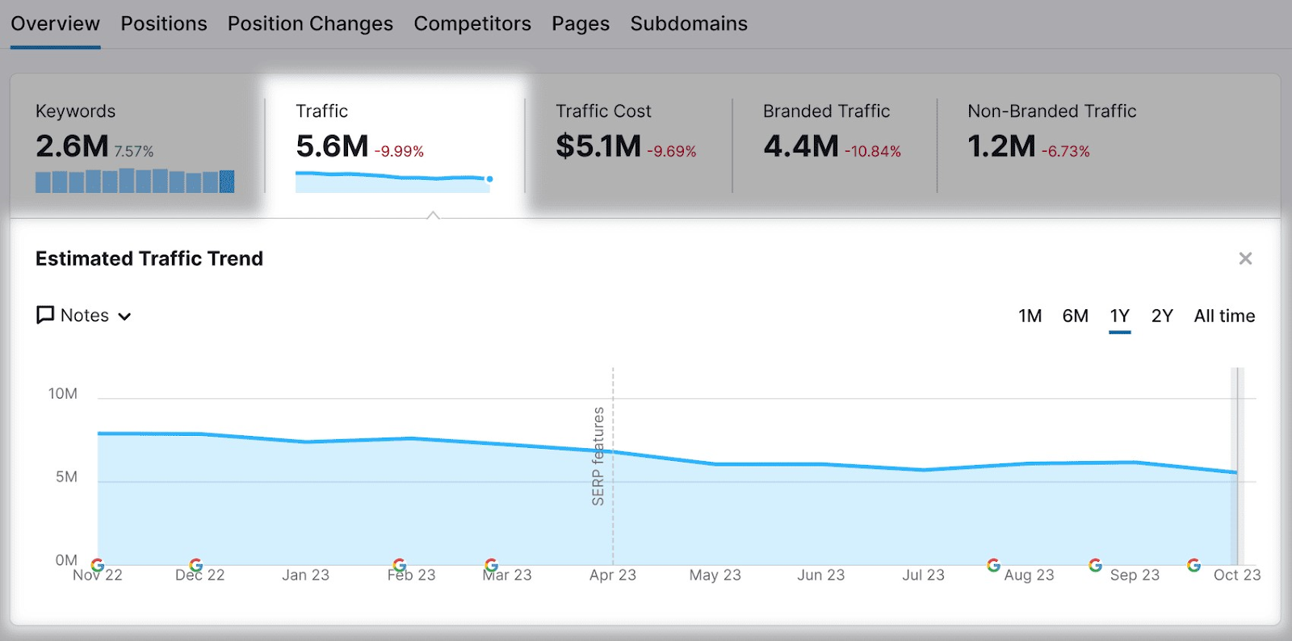
Steps to track your metrics and achieve higher search engine rankings.
From here, you can drill down to see their site’s organic traffic over time.

Slide 21
Steps to track your metrics and achieve higher search engine rankings.
Conversion Performance
In addition to monitoring your total organic search traffic, you’ll want to track conversions to gauge the quality of the traffic you’re receiving.
Meanwhile, use these KPIs to connect your search and content marketing strategies to sales and revenue for higher traffic:
Ecommerce sales from organic search: If you run an ecommerce business, this measures the number of direct product sales that came from organic search
Sales or conversions from organic search: If you have another type of business, this indicates the number of sales, conversions, or leads from organic search
Specific keyword rankings: Rankings of critical web pages and keywords that matter most to your business
Bounce rate of organic traffic: Percentage of visitors from organic search that leave after viewing just one page on your website
SERP CTR: Percentage of search impressions that result in a click to your website

Slide 22
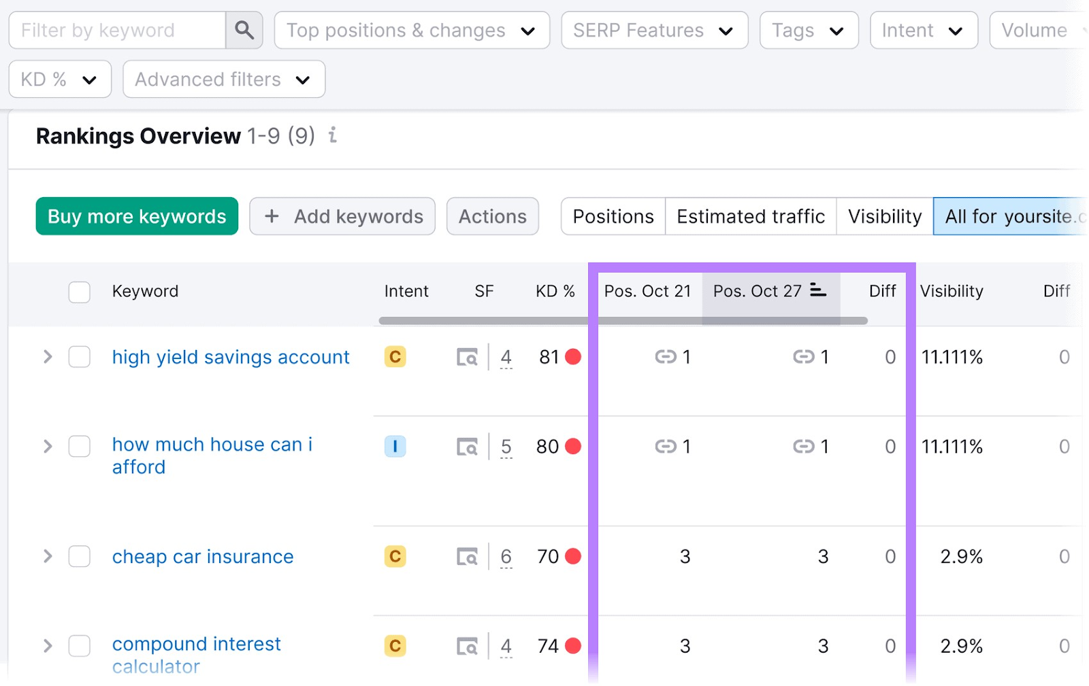
Steps to track your metrics and achieve higher search engine rankings.
For example, using Semrush’s Position Tracking tool, you can input your most valuable keywords and track their performance over time.

Slide 23
Steps to track your metrics and achieve higher search engine rankings.
SEO Impact on Your Overall Marketing Strategy
Track the share of traffic and conversions coming from SEO versus other channels. Like pay-per-click (PPC), Google Ads, social media, and referrals.
This will give you an apples-to-apples comparison of how SEO is impacting your website traffic and your business.
You’ll need to monitor:
SEO traffic share: Percentage of total website traffic that comes from search engines
SEO conversion share: Percentage of total website conversions that come from search engines

Slide 24
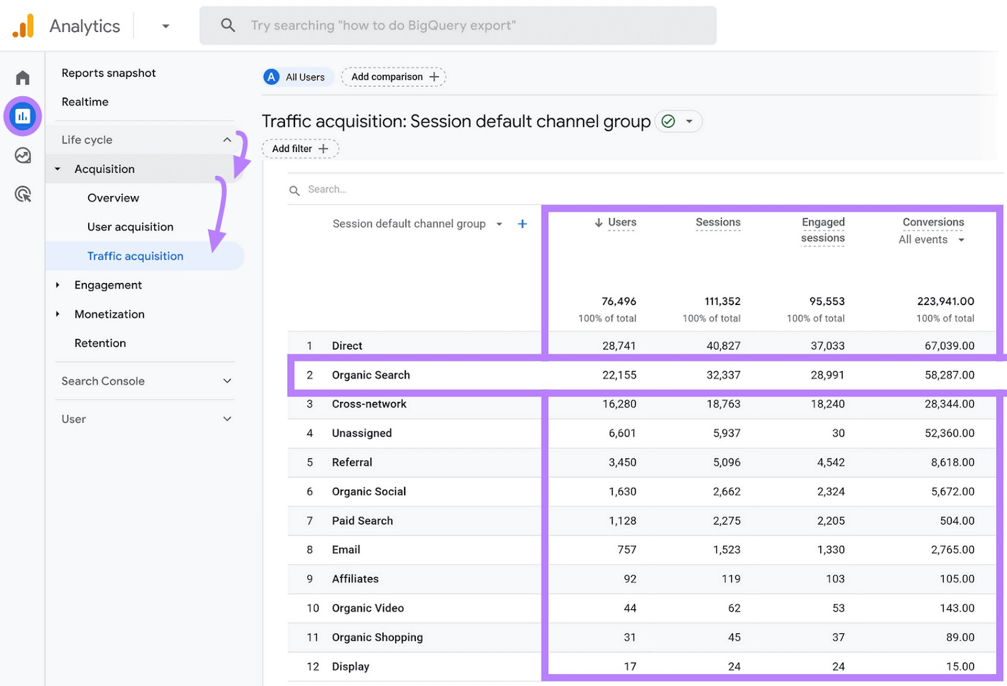
Steps to track your metrics and achieve higher search engine rankings.
Navigate to “Reports” > “Life cycle” > “Acquisition” > “Traffic acquisition.” Compare organic search traffic (users, sessions, and engaged sessions) and conversion metrics to other sources.

Slide 25
Steps to track your metrics and achieve higher search engine rankings.
Site Health
SEO errors: Number of potentially severe errors or issues on your site related to SEO best practices (e.g., broken links, 404 errors, pages not crawled, slow page speed)
Crawlability: Percentage of pages on your site that are easy to crawl and index
Internal linking: Percentage of pages on your site that contain at least one incoming and outgoing link to other pages on your site
Site speed and performance: Percentage of pages on your site that load quickly and conform to site performance standards

Slide 26
Steps to track your metrics and achieve higher search engine rankings.
Domain Authority
Use quantifiable metrics to estimate your site’s authority. Track it over time and monitor progress on link-building strategies intended to boost your presence in search engines.
These KPIs are generally based on the number and quality of backlinks to your site:
Domain authority score: Overall numeric representation of your site’s authority rating
Total backlinks: Number of incoming backlinks pointing to your site
Referring domains: Number of unique websites (domains) with at least one link back to your site
Average domain authority of backlinks: Average score or rating of the sites that link back to yours

Slide 27
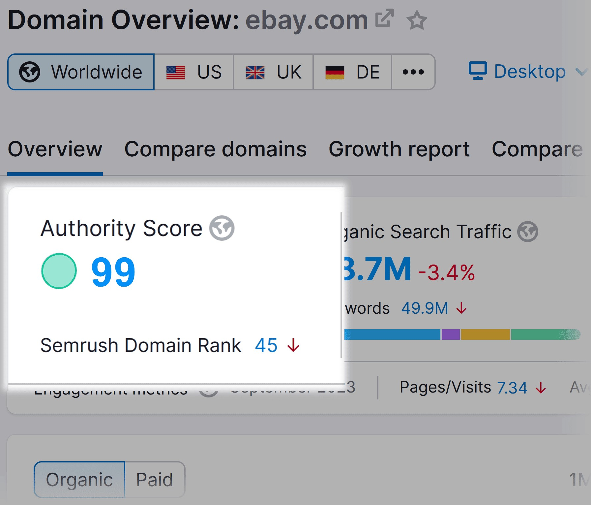
Steps to track your metrics and achieve higher search engine rankings.
Use the SEO Dashboard or Domain Overview from Semrush to measure and track your domain authority (“Authority Score”). This score indicates the SEO performance and overall quality of a domain or web page.
For example, eBay has an authority score of 99, but a smaller or less popular website may have an authority score of 20, 30, or lower. The higher, the better.

Slide 28
Steps to track your metrics and achieve higher search engine rankings.
Local SEO
Measuring SEO performance for a local (i.e., brick and mortar) business?
Then you’ll want to track KPIs and metrics specifically associated with local search results.
Consider these KPIs to gain insight into your local SEO performance:
Local search rankings: Search rankings for keywords that have local intent (e.g., “hair salons in Minneapolis”)
Phone calls: Number of phone calls generated from local search results and “Call” functionality
Appointments: Number of appointments or bookings generated from local search results

Slide 29
How to Use SEO Analytics to Improve Website Performance
1. Create an SEO Reporting Dashboard
SEO reports or SEO dashboards give you a template for collecting and analyzing your SEO metrics. Ideally, they show you a range of metrics you can track over time to measure progress toward your SEO goals.
Here’s how to set it up:
Click “SEO Dashboard” in the left-hand menu. Then click “Create project.”
From the “Create project” dialogue box, enter the URL of your website under “Domain.” Click “Create project” here as well.
You’ll be taken to the SEO Dashboard for your new project.
Right away, you’ll be able to see some KPIs that you likely identified as part of your SEO analytics strategy.
Under the “Domain Analytics” widget are key metrics like “Authority Score,” “Organic Traffic,” “Organic Keywords,” and “Ref. Domains” (referring domains).

Slide 30
How to Use SEO Analytics to Improve Website Performance
Here’s a quick overview of what these metrics mean:
Authority Score: A Semrush metric that measures the overall authority of your website. It’s based on the number and quality of backlinks pointing to your domain, website traffic, and more
Organic Traffic: A real-time measurement of your site’s monthly organic traffic based on your ranking keywords
Organic Keywords: The number of keywords for which your website currently ranks in the top 100
Ref. Domains: The number of unique websites (domains) that link back to your website
Scroll down the page to the “Traffic Analytics” widget. This measures your website’s total traffic from all sources (including organic traffic).

Slide 31
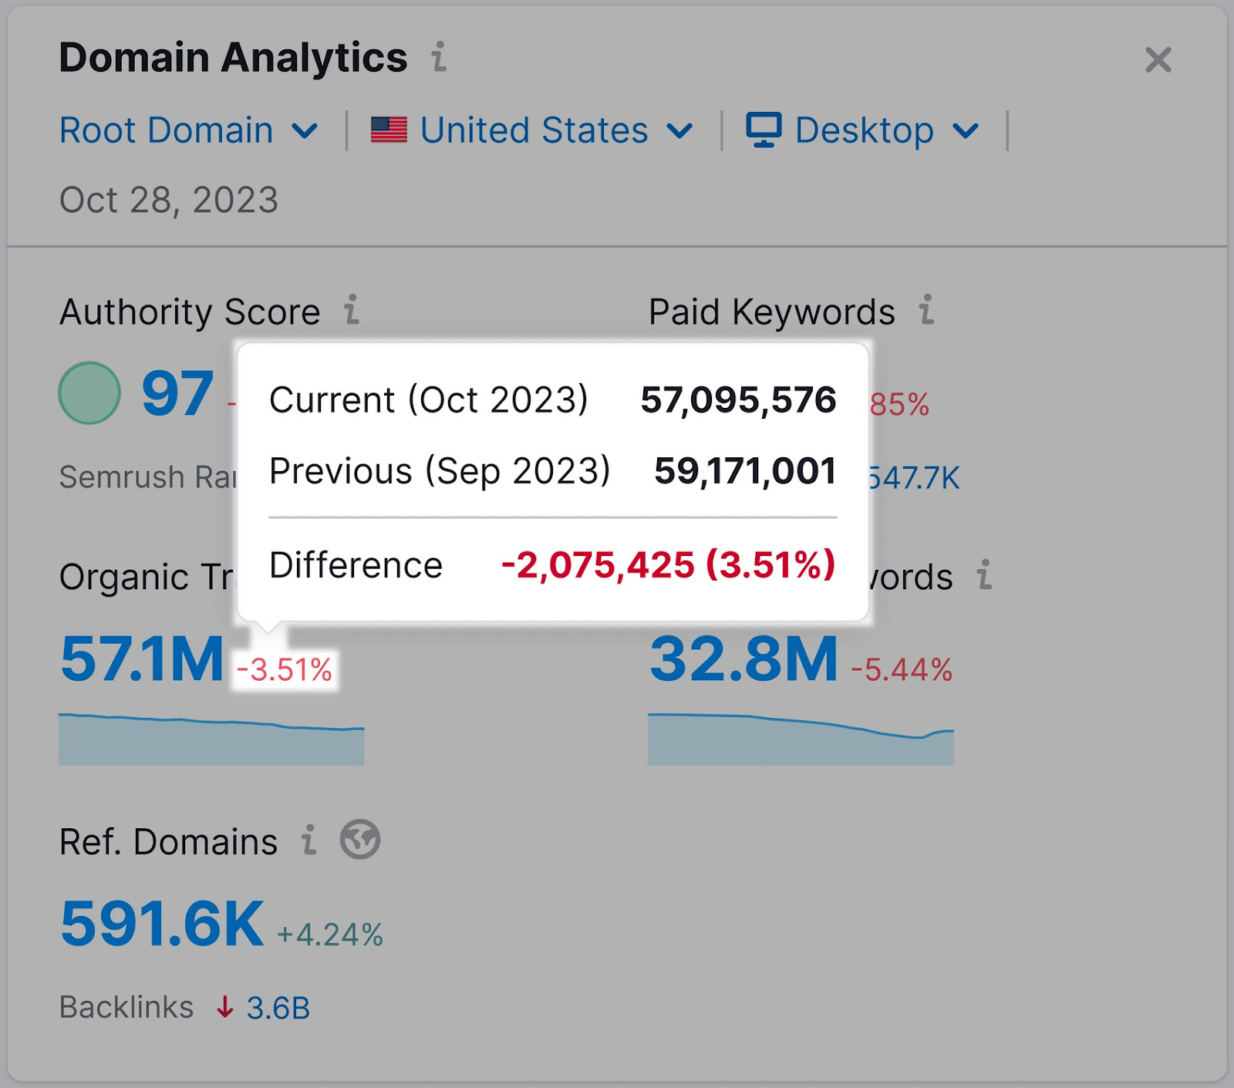
How to Use SEO Analytics to Improve Website Performance
2. Track SEO Analytics Over Time
The SEO Dashboard will automatically monitor metrics and update with new data.
Next to most metrics, you’ll see a change indicator. This shows whether that metric has gone up or down, and by how much, compared to the previous period.
Hover over the change indicator to get the details.

Slide 32
How to Use SEO Analytics to Improve Website Performance
3. Continuously Review Your SEO Analytics
Implement a review process that involves assessing your analytics data and creating specific action items based on the findings.
This works in a three-step process:
Analyze the data and identify trends
Ask a question
Propose an action item
Steer Your SEO Analytics to Success
This 4-step approach to SEO analytics will keep you at the top of your game. It’s all about monitoring your website’s performance, identifying improvement opportunities, and fine-tuning your approach and strategy accordingly.

Slide 33
References
Books and Journals
Eric Enge, Stephan Spencer, Rand Fishkin, Jessie C Stricchiola, “The Art of SEO : Mastering Search Engine Optimization”, O'Reilly Media, October,2009.
https://www.hubspot.com/hs-fs/hub/53/file-13221845-pdf/docs/ebooks/introduction-to-seo-ebook.pdf
Fhttps://www.startupgeeks.it/wp-content/uploads/2018/12/ebook-seo-sej-complete-guide-2018.pdf
Video Link-
https://www.youtube.com/watch?v=bLUkIgY8MTE&list=PLjVLYmrlmjGdNxIBIdaDEHtI4gAxaYoq1&ab_channel=WsCubeTech
https://www.youtube.com/watch?v=83RXYrqRLeM&list=PLNfnAKZ4Zsar3Jwb59D0dJeQ-RnsaqpoT&ab_channel=UmarTazkeer
Web Link-
https://www.semrush.com/blog/seo-analytics/
https://www.tutorialspoint.com/seo/index.htm

